Slide 1

ANALYSIS OF E-COMMERCE STORE DATA

Slide 2
QUICK TAKEAWAYS
The data is from an online e-commerce store.
All the visuals=> Tableau
Between 2016 and 2018
Customers mostly from Brazil.
Some customers: Few South American countries, USA and some countries in Europe.
Majority sellers from Brazil.
Preferred language: Spanish.

Slide 3
SALES ANALYSIS
Total Sales
$ 16.01M
Sales over the period 2016-2018.
Majority of sales on weekday
Each year(except 2016): Monday Tops sales and Saturday bottoms sales.
Weekend: Difference in sales between Saturday and Sunday not alarming.
Weekday Sales
$ 12.37M
Weekend Sales
$ 3.64M

Slide 4
SALES ANALYSIS
Monday | $ 2.62M
Tuesday | $ 2.56M
Wednesday | $ 2.49M
Thursday | $ 2.38M
Friday | $ 2.31M
Weekday Sales
$ 12.37M
Each year(except 2016): Monday Tops sales and Saturday bottoms sales.
Weekend: Difference in sales between Saturday and Sunday not alarming.
Weekend Sales
$ 3.64M
Saturday | $ 1.77M
Sunday | $ 1.87M

Slide 5
SALES ANALYSIS
Monday | $ 2.62M
Tuesday | $ 2.56M
Wednesday | $ 2.49M
Thursday | $ 2.38M
Friday | $ 2.31M
Weekday Sales
$ 12.37M
It looks like the weekend drives the sales into the weekday.
Customers continue their shopping well into Monday the sales drop
Until they reach weekend, where the sales pick up and cycle continues
Weekend Sales
$ 3.64M
Saturday | $ 1.77M
Sunday | $ 1.87M

Slide 6
SALES ANALYSIS
We should focus more on weekends, as they drive customers to continue to shop even when the weekday begin.
Adding more offers and benefits during Saturday and Sunday could potentially increase the shopping period=> could increase even more sales on Monday.
Also, Saturday (could be half-day) and Sunday are usually holidays for most working professionals: could be a reason for monday.
Insufficient data on public holidays: similar approach could work.
Monday | $ 2.62M
Tuesday | $ 2.56M
Wednesday | $ 2.49M
Thursday | $ 2.38M
Friday | $ 2.31M
Weekday Sales
$ 12.37M
Weekend Sales
$ 3.64M
Saturday | $ 1.77M
Sunday | $ 1.87M

Slide 7
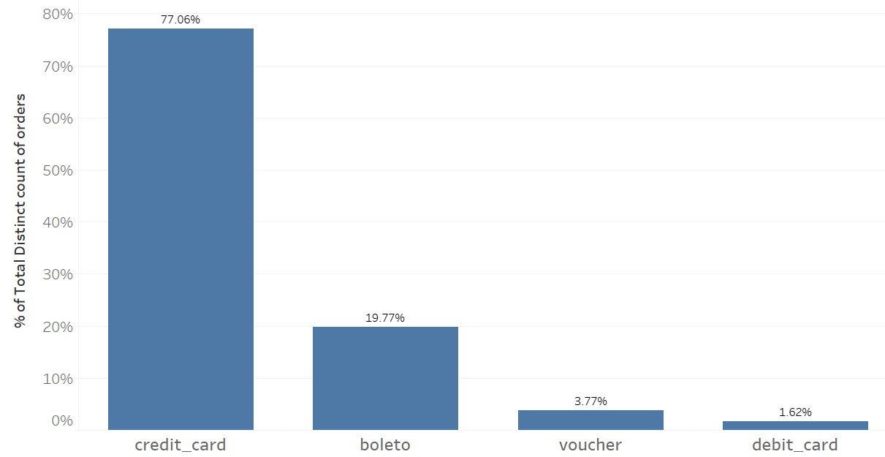
PAYMENT TYPE ANALYSIS
It is evident highest sales via credit card.
More tie-ups with the banks to offer better offers could improve sales.
Payment mode via boleto is the second most preferred but makes up less than 20%. True across years
Most and Least preferred payment mode
CREDIT CARD
DEBIT CARD

Slide 8
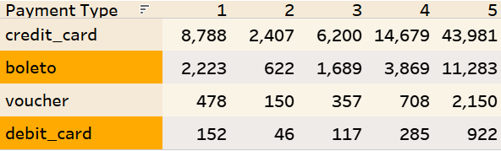
Number of orders with review score 5 and different transaction modes
As seen previously, credit card transactions tops overall transaction modes. This combined with review score can be seen on the right table.
Across all the scores, number of orders made via credit card is the highest
Increasing in-site vouchers and providing vouchers of our company on other platform could potentially lead new customers on to our platform.

Slide 9
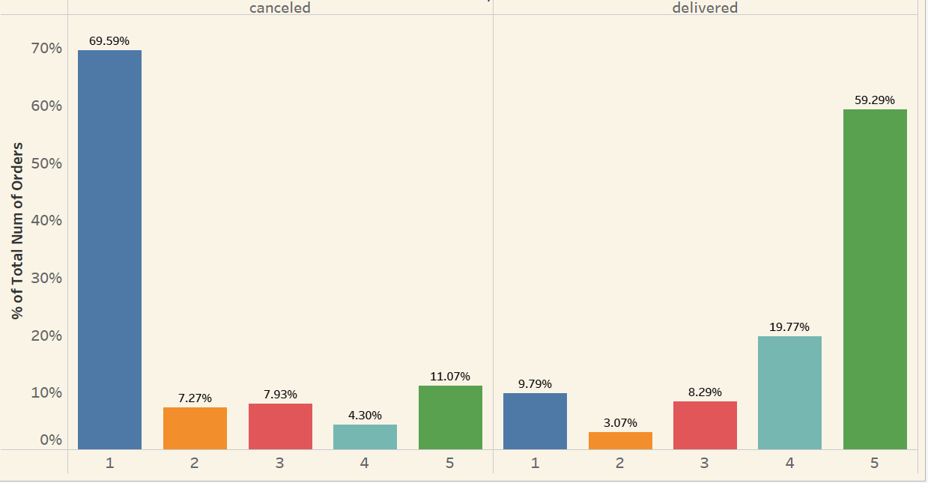
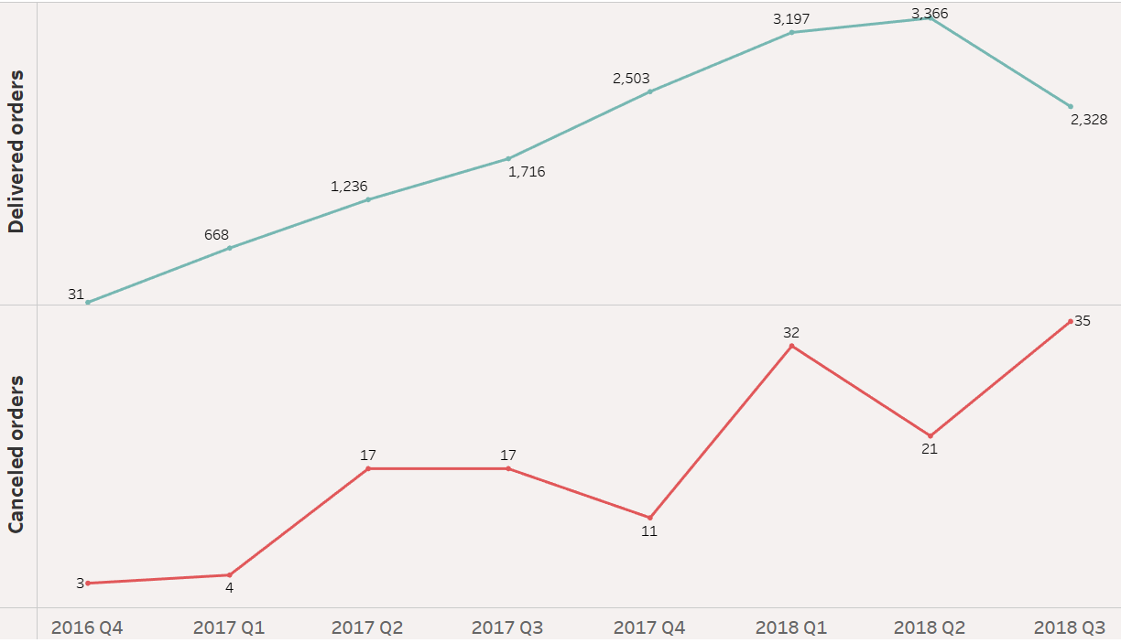
REVIEW SCORE ANALYSIS
Focused on two types of order status: canceled and delivered.
Majority of customers(70%) who cancelled their orders have given score of 1.
Reasons: Could be due to bad products which did not live upto their expectations or the whole shopping experience (including shipping days) was bad.
But once delivered, customers (around 60% overall) were extremely satisfied with the products (clearly given by score of 5).

Slide 10
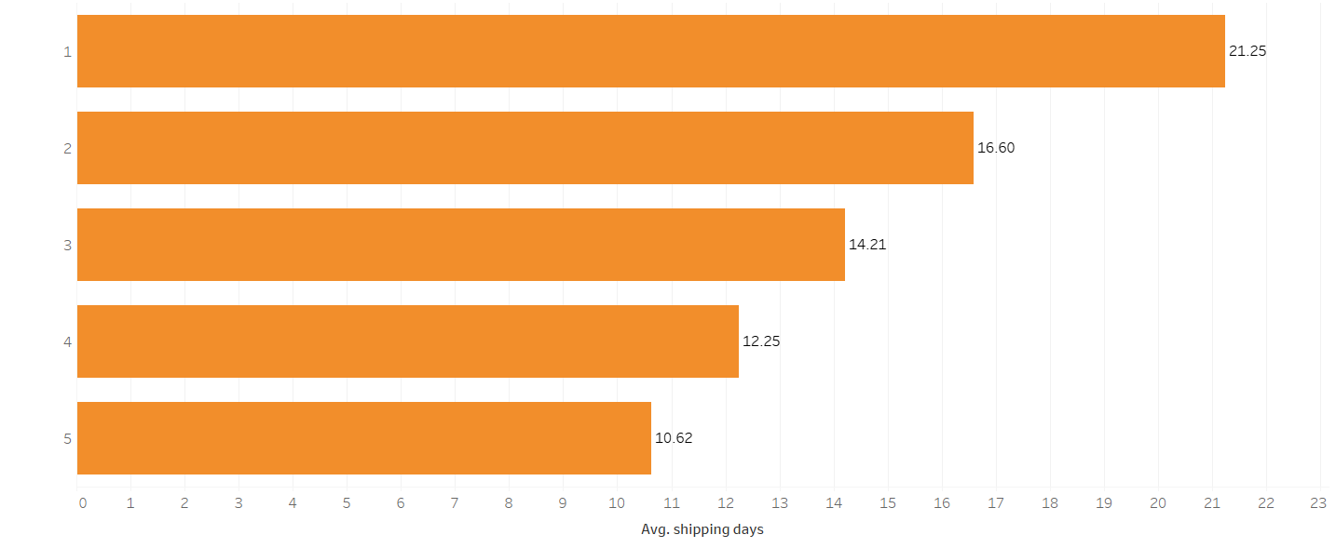
REVIEW SCORE ANALYSIS
It is observed that as the average shipping days increase, customers tend to provide lower scores.
This shows customers frustrations with the logistics.
Somewhere within two weeks is the sweet spot as shown below in the chart.
This observation is for all the products combined and for individual products it might vary

Slide 11

REVIEW SCORE ANALYSIS
Final inferences ( not for individual products)
Review score does affect most of the customers. Some customers might just look at the lower price rather than the review score (More data is needed to ascertain more on this ).
Number of shipping days plays a crucial role in determining the review score which drives most the customers’ frequency to visit the e-commerce site for shopping and also to improve sales. Therefore,
Improve logistics reduce shipping days improve ratings customers happy increase revenue
Even though we cannot have complete control over the product quality, stricter rules have to put forth to improve quality and other factors of the product (fight against fake or empty products) improve overall customer experience decrease ord.er cancellations.

Slide 12
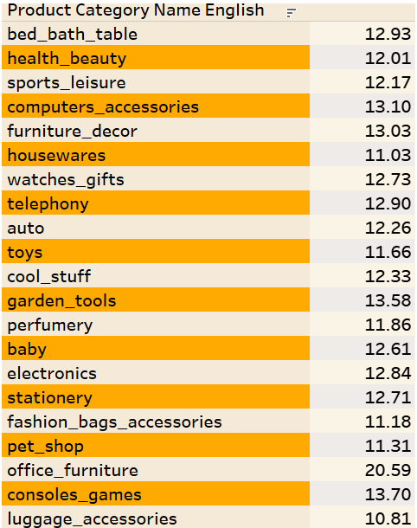
AVERAGE SHIPPING DAYS ACROSS PRODUCT CATEGORIES
The table on the right shows few of the many product categories that exist on the site and its respective avg. shipping days.
For example: avg. shipping days for pet shop=11
Max. Avg. shipping days: 20 days for office furniture.
The sweet spot is 14 days for average review, therefore bringing down the avg. shipping days even lower could be useful for the company by setting up more inventories across cities.

Slide 13
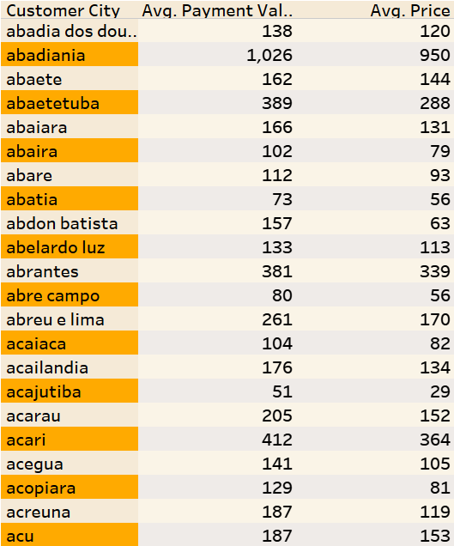
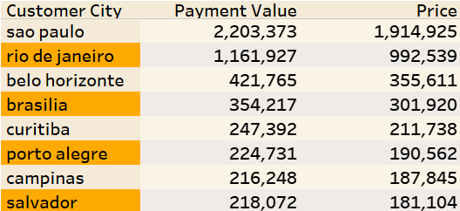
AVG. PRICE AND AVG. PAYMENT VALUE ACROSS CITIES
For example: avg. price : $108 and avg. payment value: $135 from Sao Paulo City
Max. avg. price : $2325 and Max. avg. payment value: $2200 from Pianco city.
A large chunk of payments is coming out of Sao Paulo and Rio De Janerio.
And the difference between payment value and price is tallied by the freight value.

Slide 14
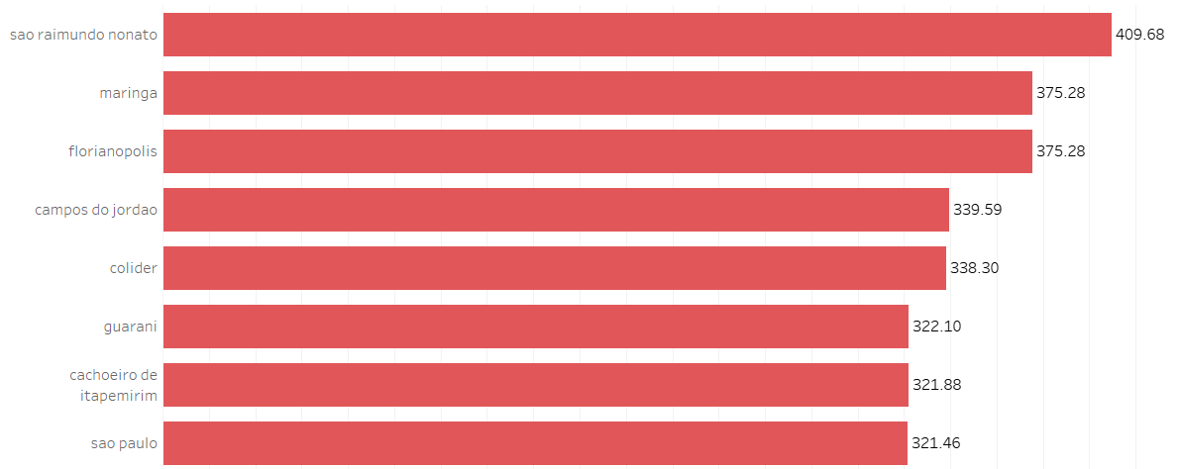
AVG. PRICE AND AVG. PAYMENT VALUE ACROSS CITIES
Freight value for Sao Paulo city is $321 and for Rio de Janerio $194.
For the costliest freight value city Sao Raimundo nonato, the total payment value is just $2987.
Though, freight value may not completely paint the total payment collected from each city, it is nevertheless is important to reduce the freight cost.

Slide 15

CONCULSIONS
Improve logistics to decrease number of shipping days and decrease the freight value.
Stricter rules for quality control.
Investing on on-site and off-site vouchers to attract customers.
Better offers on credit cards to increase revenue
Set up better deals on weekends, which translates to better weekday retention of customers’ shopping spree.
For dynamic viewing experience of the visuals-
Tableau Dashboard: Dashboard Online

